Slide 1
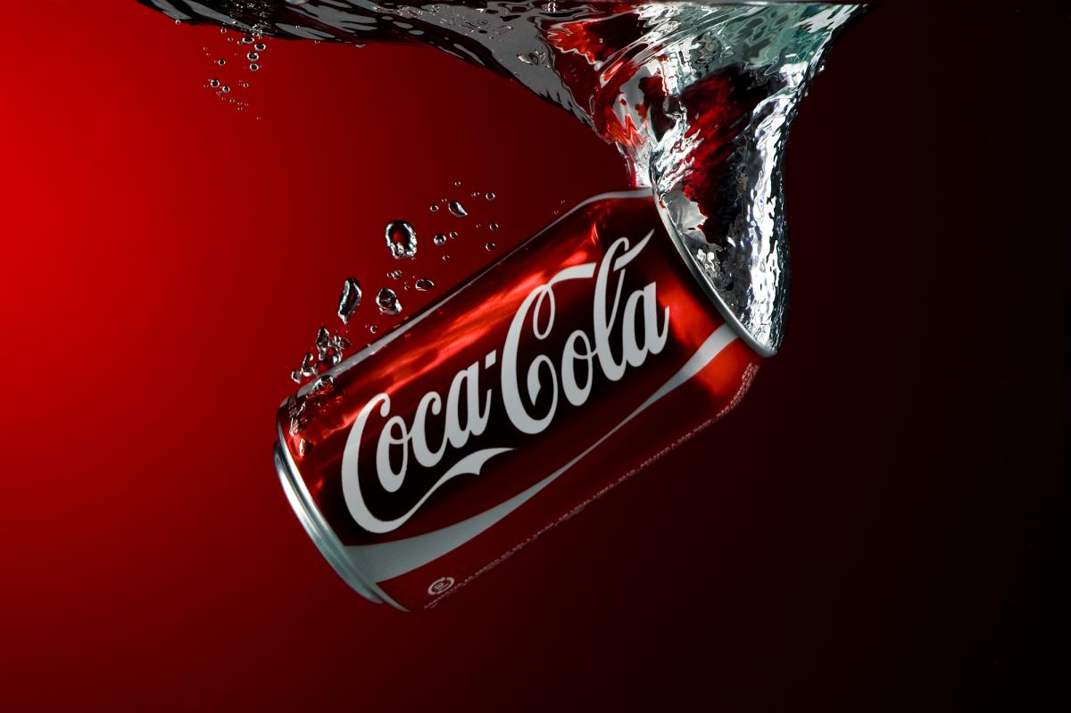

Coca-Cola
Practical Project
Members:
Yailyn Duarte
Enni
Niko
Andreas Litt
Marketing
November, the 3rd 2022

Slide 2

Market Segmentation

Slide 3
Market Segmentation
Segmentation:
Bases (and Variables) used :
Geography (mainly Countries)
Demographics (Age)
Psychographics (lifestyle : healty life → diet coke)
Targeted Segments:
Everyone, but mainly Teenagers young adults
All countries, except Cuba Russia North Corea
Targeting Strategy :
Differentiated Targeting Strategy
Adapt to market requirements (e.g. US-Market : bigger bottles because they have bigger fridges)
Adapt to „seasons“ (different Marketing around Christmas than in Summer)
some material is used all over the globe/all year

Slide 4
How does Coca-Cola position itself?
Joy/Happiness bringing → show moments that everybody has experienced happiness in (with friends)
Sociable/family-friendly → advertisments show group of friends or happy family
More than a drink/Coca Cola as a Lifestyle → advertise with slogans like „Real Magic“ ; show active people
Refreshing → use the „ahhh“-sound
High quality (relative to other softdrinks)
Affordable/available
Socially progressive → present themselves as open/inclusive/integrating (super bowl ads promoting equality)
Positioning
Positioning Variables:
Trustworthiness
Taste/quality
Affordability
Availability
Social progessivism

Slide 5
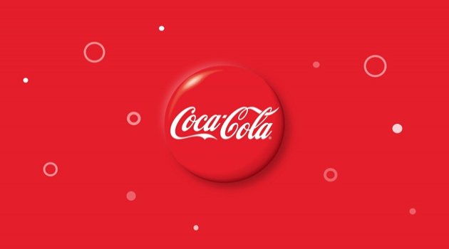

Slide 6
Product

Slide 7
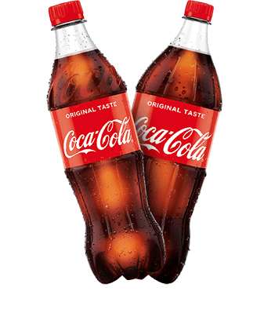
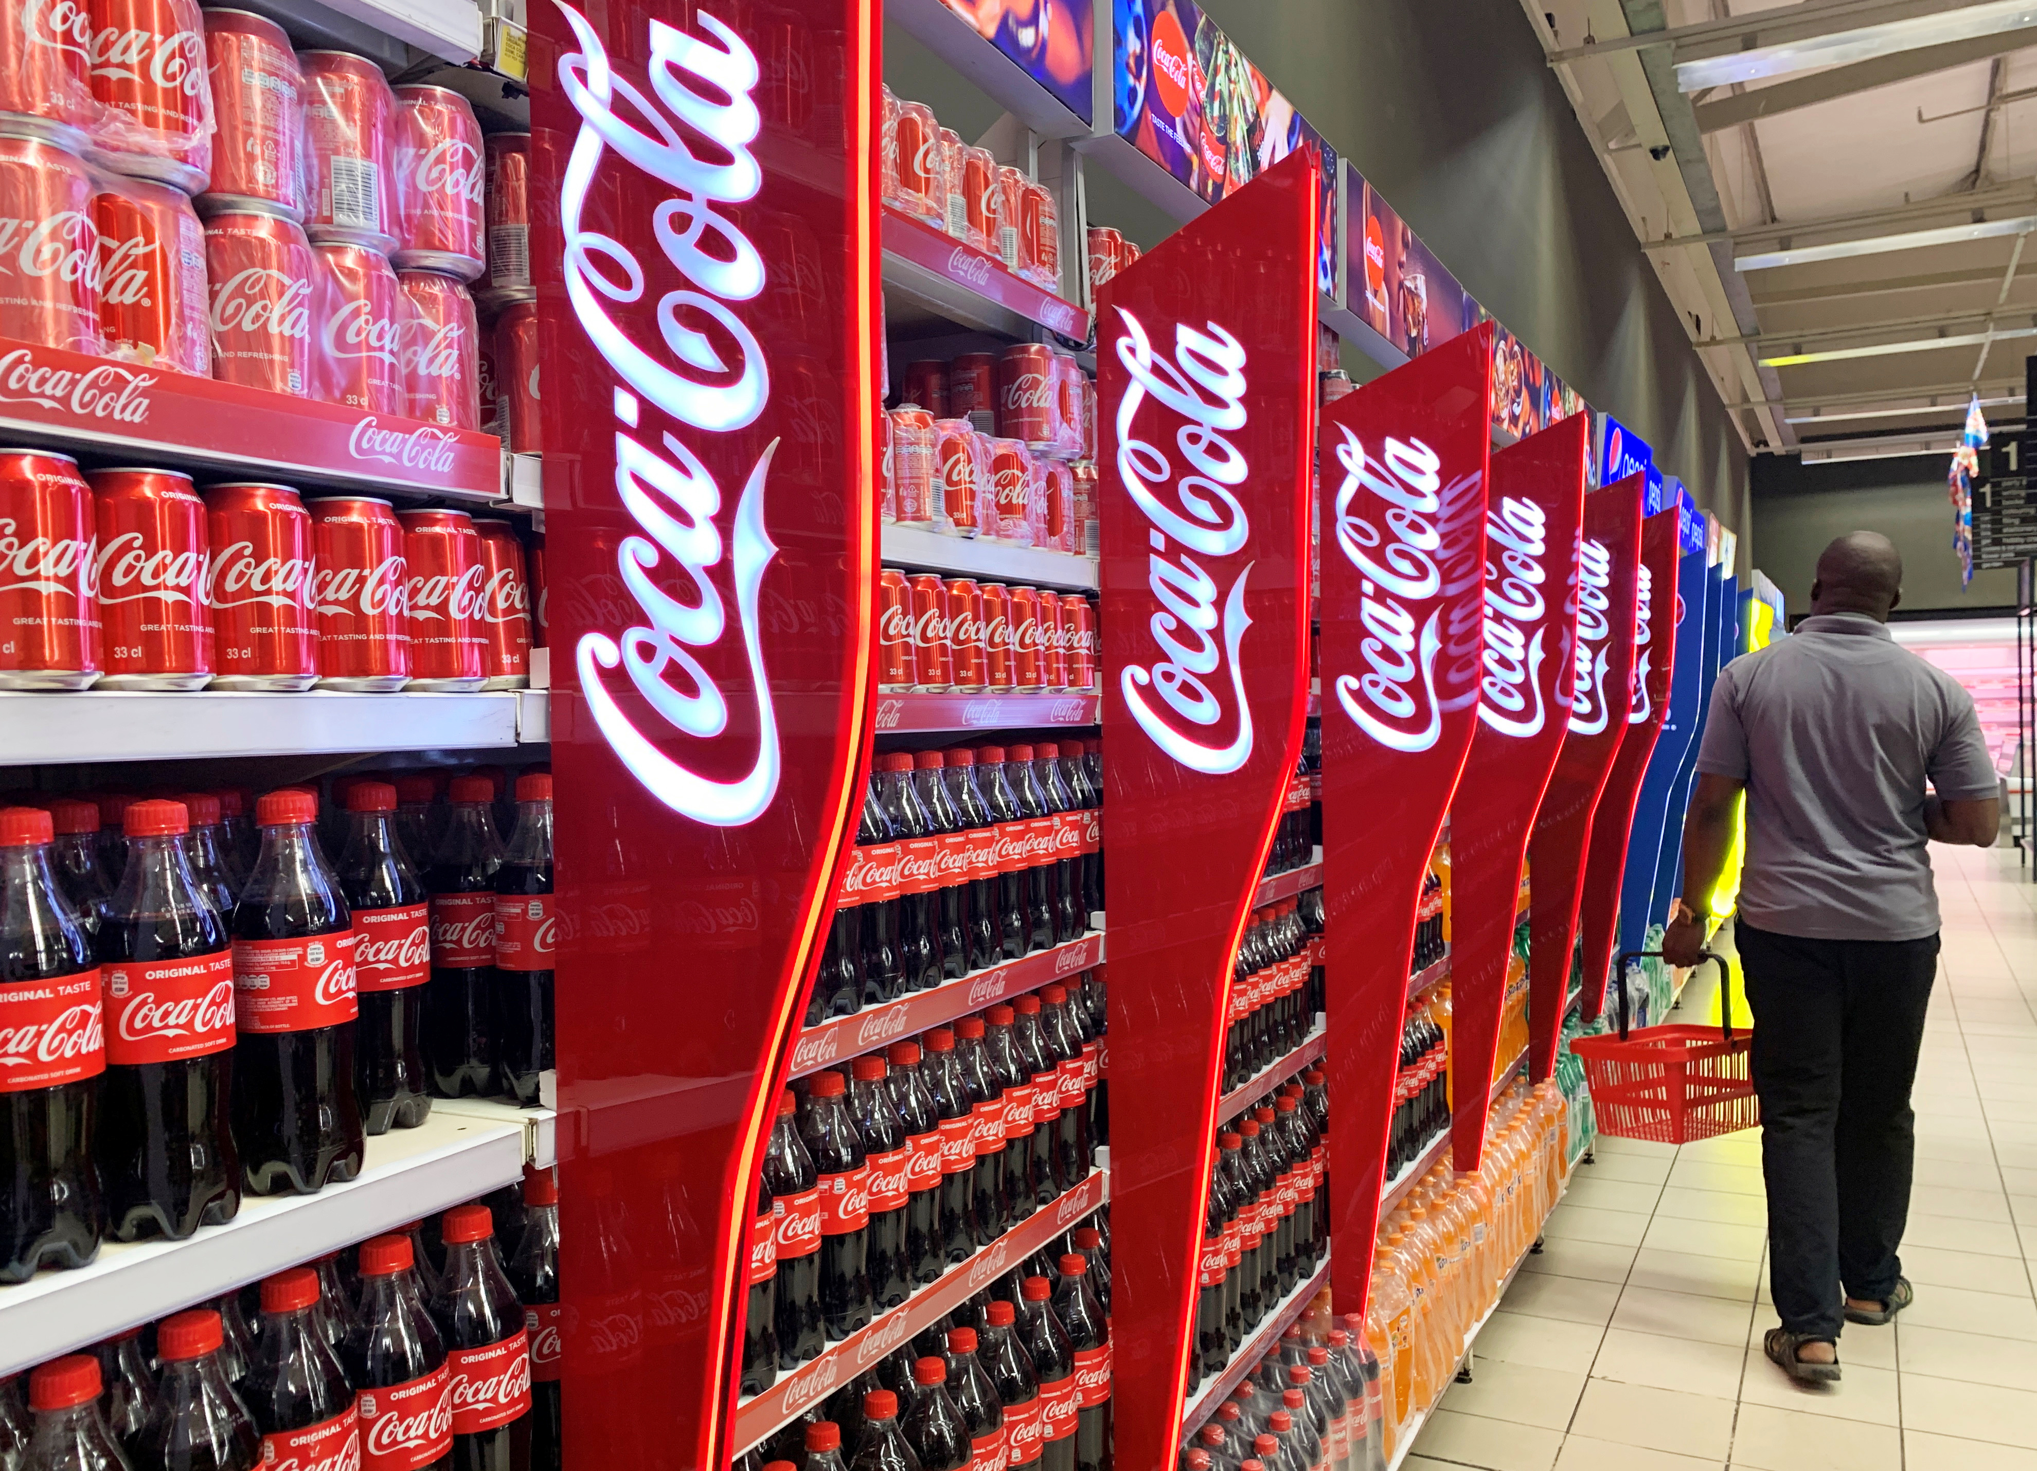
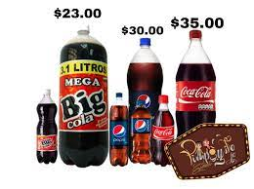
What kind of product is Coca-Cola?
Coca-Cola can be considered a specialty product and convenience product.

Slide 8
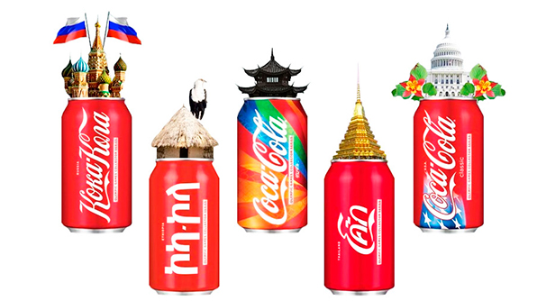

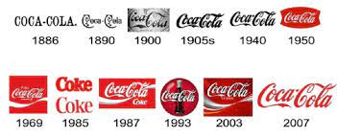
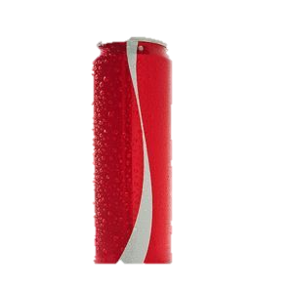
Coca-Cola Design
1886
Delicious and Refreshing
Name
1904
Drink Coca‑Cola
1905
Coca‑Cola Revives and Sustains
1988
You Can’t Beat the Feeling
2001
Life Tastes Good
Logo/ Design
2006
The Coke Side of Life
2009
Open Happiness
Slogan
throught the years
2021
Real Magic

Slide 9


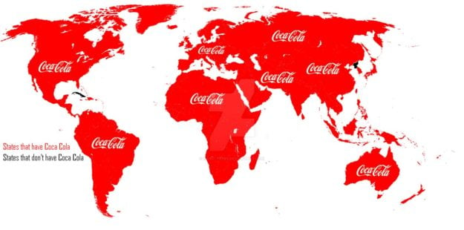

Where can you find Coca-Cola?

Slide 10
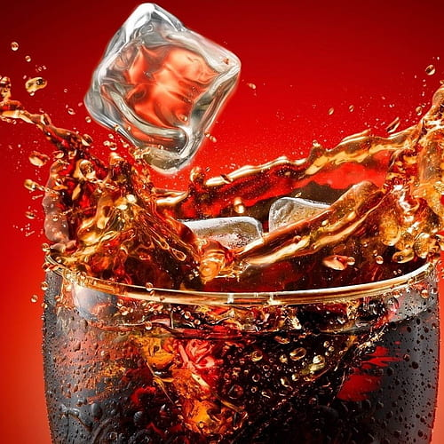
Name Change
The taste changes

Slide 11
Product Life Cycle
Sales
Profit
Time
Product
development
Introduction
Growth
Maturity
Decline

Slide 12
Coca-Cola Failures
Yes, Coca-Cola Yes, Coca-Cola failed when it came to some new flavors in their products.
Sales
Profit
Time
Product
development
Introduction
Growth
Maturity
Decline

Slide 13
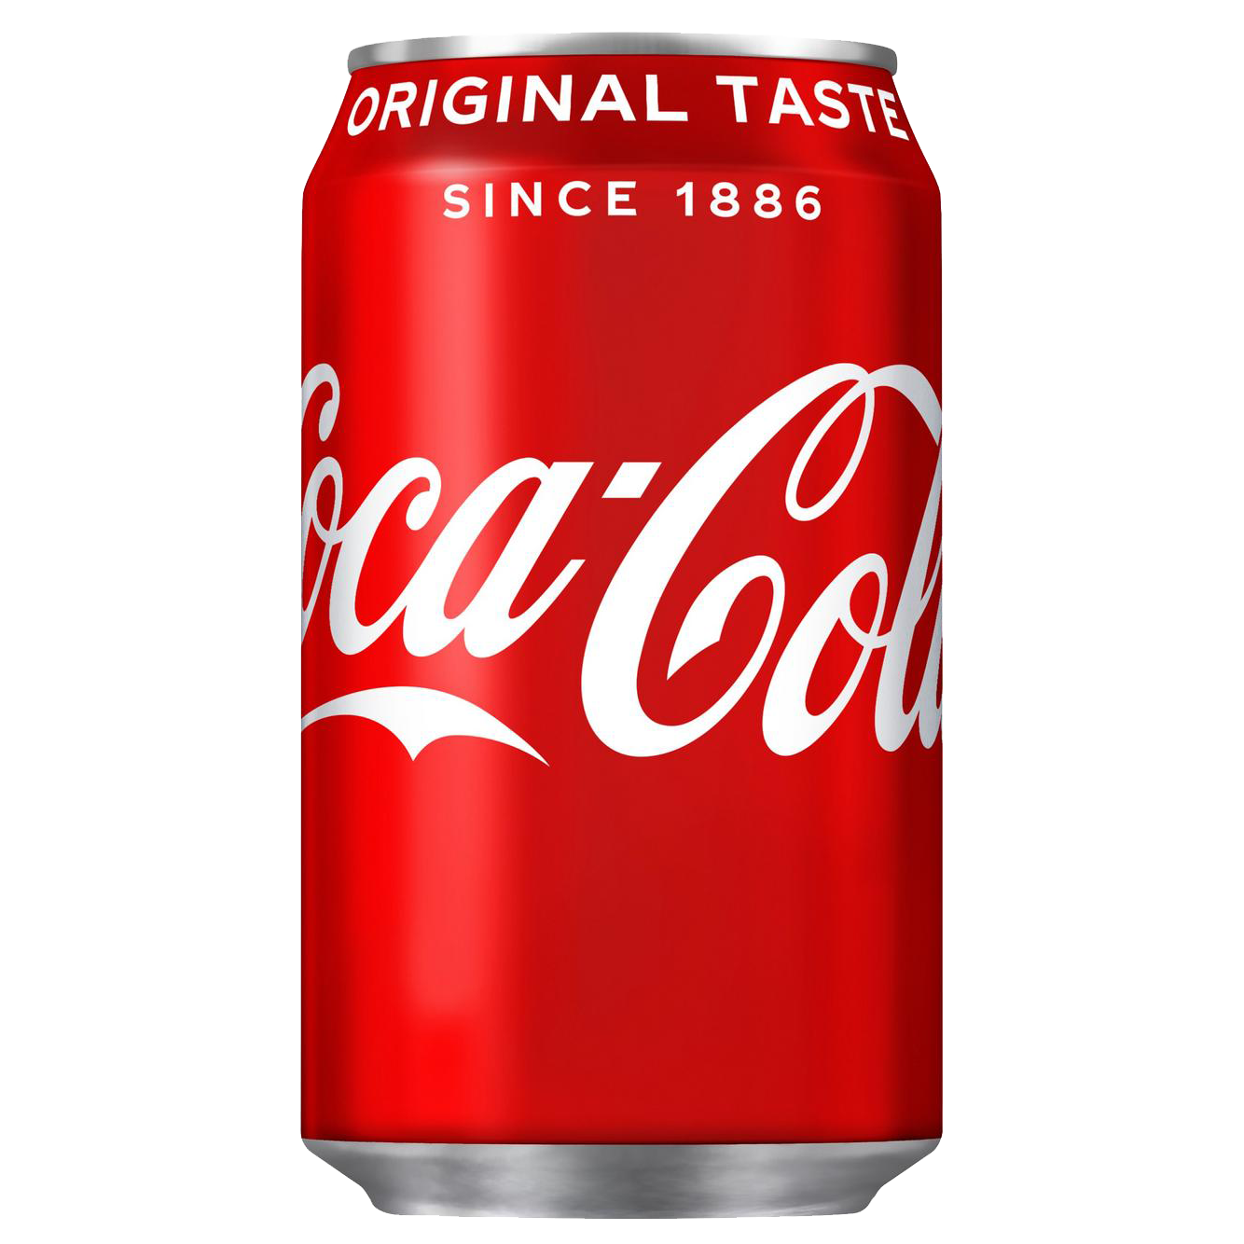
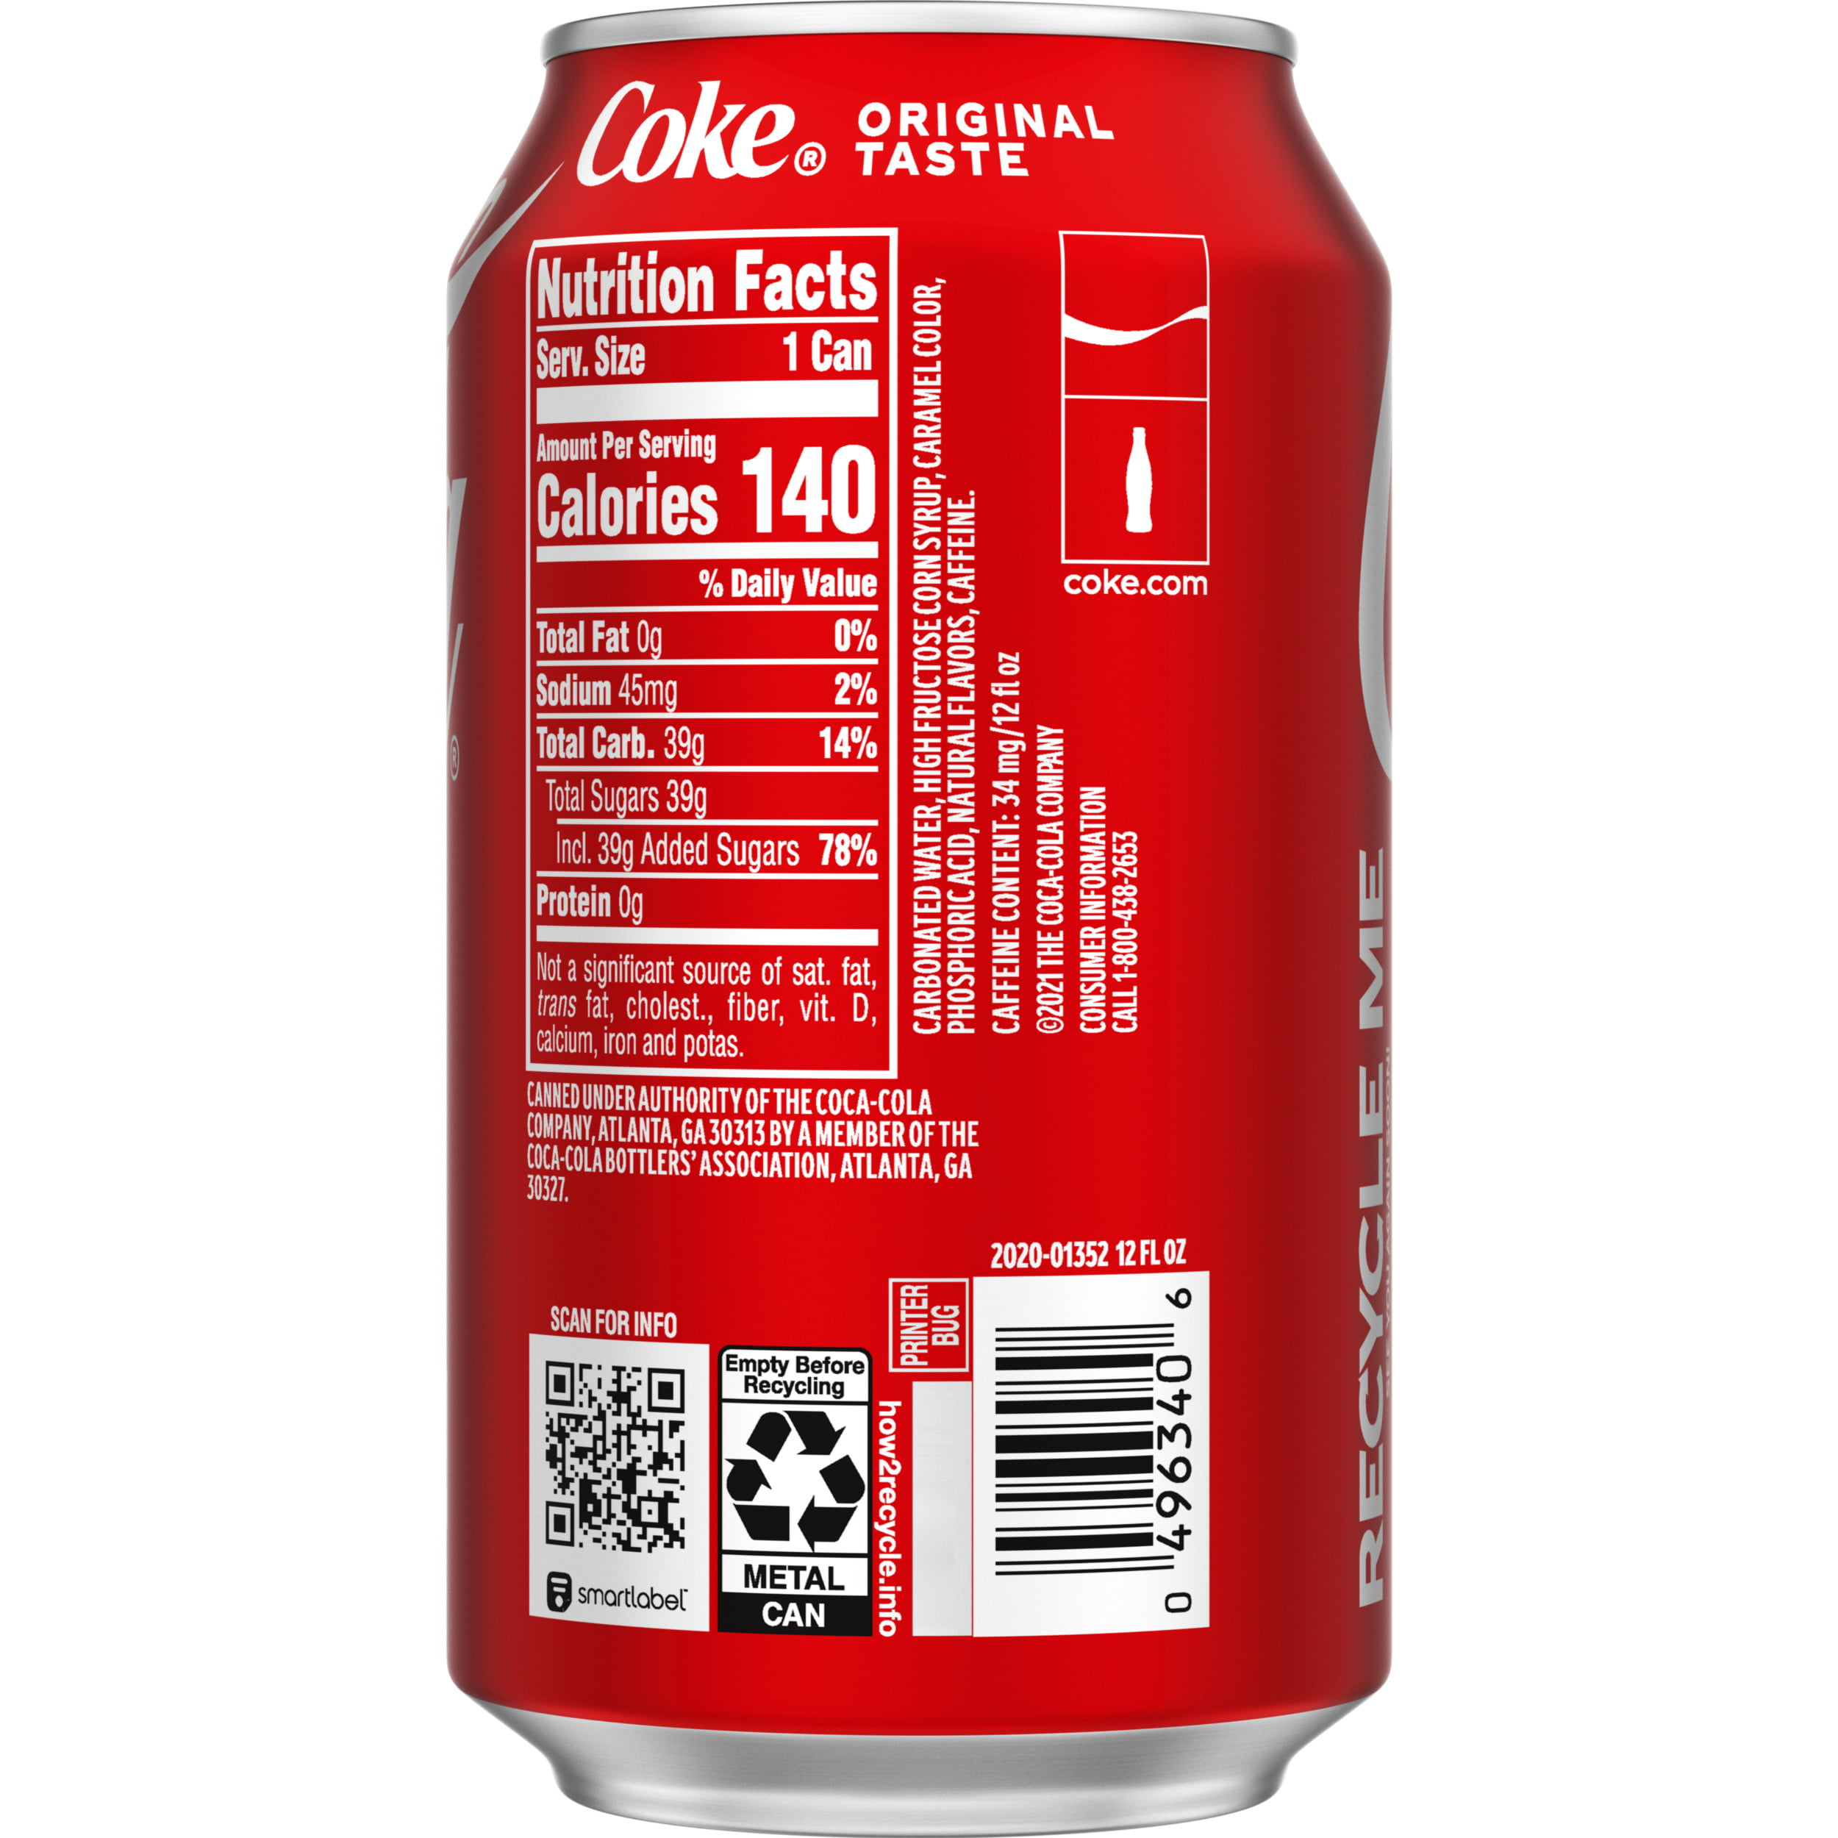

Slide 14
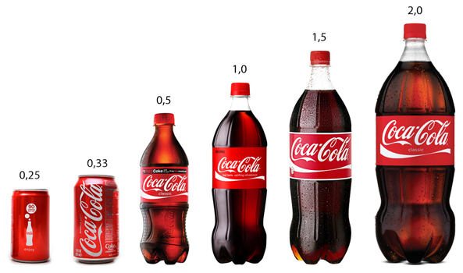
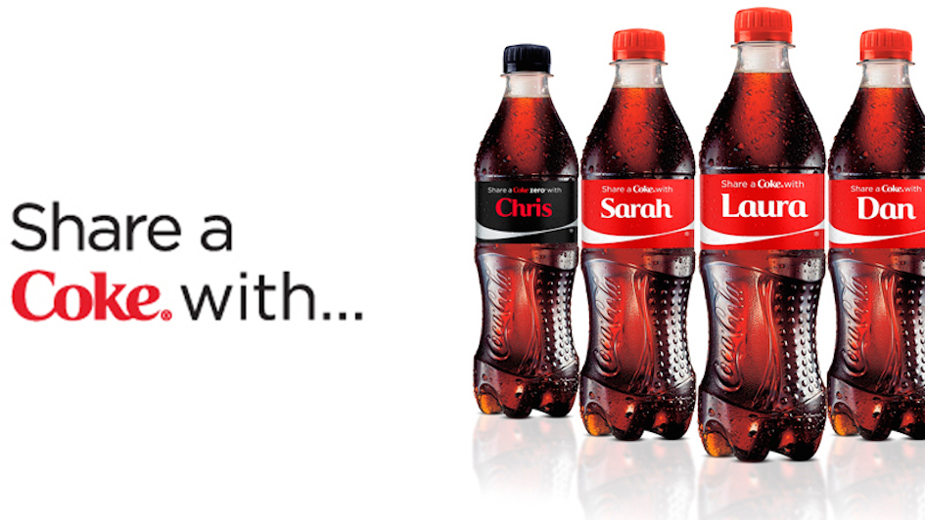
Packaging
Variety of size
Quantity of a product
Advertisement
Share a coke campaign

Slide 15
Pricing

Slide 16
Price
Average Price : 1,19$

Slide 17
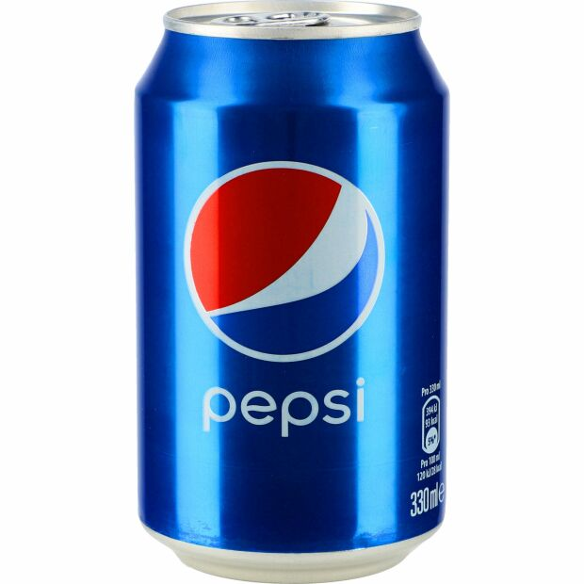
1,19$
1,19$

Slide 18
Pricing Tactics
Status quo pricing
Market penetration pricing policy

Slide 19
Place

Slide 20
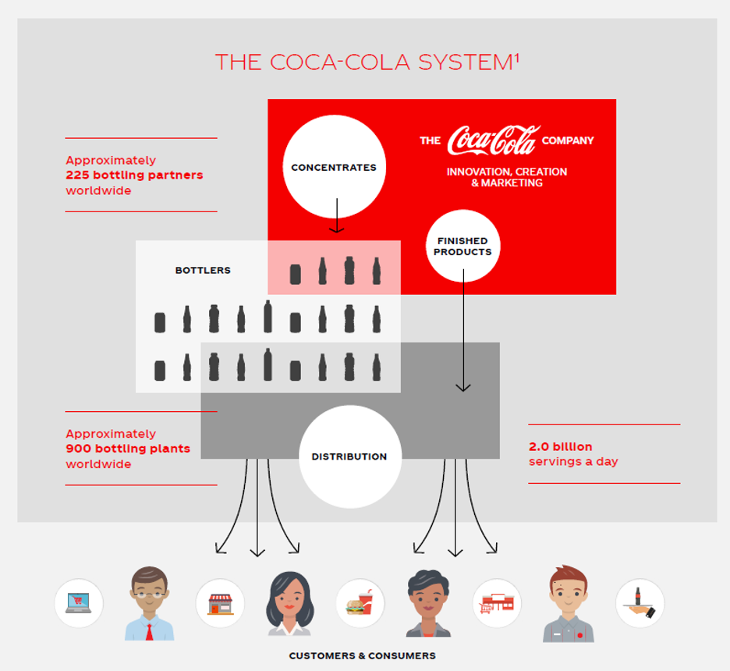
Place - Distribution
2.0 billion products every day Global business on a local scale CocaCola sells concentrates Botteling partners manufacture and distribute
Why?
Product does not travel far

Slide 21
Promotion

Slide 22
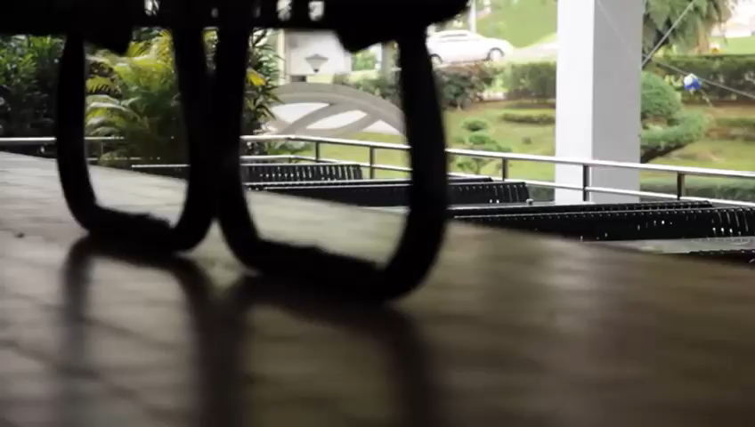

Slide 23
